Slide 1



A DEEP LEARNING BASED APPROACH FOR SPEECH EMOTION RECOGNITION
Presentation by:
ALEN M JOHN
AI 04
PG2 - M.Tech in AI
Centre for Artificial Intelligence
TKMCE
Internal supervisor:
Dr. Anzar S M
Asst. Professor
Dept of Electronics and
Communication
TKMCE
Mini Project
Final Evaluation
09.05.2025

Slide 2
Contents
Introduction
Literature Review
Research Gaps Identified
Objective
Methodology
Dataset
Results and Discussion
Conclusion
Future Scope
References

Slide 3
Introduction
Emotion recognition from speech aims to analyze and classify human emotions based on voice signals.
Speech conveys emotional cues through variations in tone, pitch, intensity, and rhythm.
It plays a key role in human-computer interaction, enhancing virtual assistants, customer service systems, and mental health monitoring.
Earlier methods used handcrafted features, but modern approaches use deep learning to learn emotional patterns directly from data.
The main challenges in SER include speaker variability, background noise, and diverse emotional expressions.
Recent advancements in deep learning, especially Transformer-based models, have improved accuracy by effectively capturing contextual and temporal patterns in speech.

Slide 4
Literature Review
Author & Year | Title | Methodology | Dataset | Key Findings | Limitations
C.Luo et.al 2021 | Clustering Based Speech Emotion Recognition by Incorporating Learned Features and Deep BiLSTM | ResNet101 CNN and Deep BiLSTM | IEMOCAP | Selecting key speech segments using RBF clustering boosts emotion recognition accuracy. | Selecting only one key segment per cluster may result in the loss of emotional context.
J.Y Lee et.al 2021 | Classification of Speech Emotion State Based on Feature Map Fusion of TCN and Pretrained CNN Model From Korean Speech Emotion Data | Feature Map Fusion of Pretrained CNN (VGG19) and TCN | Korean Speech Emotion Dataset (KSED) | Feature map fusion improved the efficiency and accuracy of the proposed classification model of speech | The model is trained on a single language (Korean), which may limit its multilingual or cross-cultural applicability.
D.Kwon et.al 2022 | 3D Convolutional Neural Network for Speech Emotion Recognition With Its Realization on Intel CPU and NVIDIA GPU | 3D CNN | EMO-DB and eNTERFACE05 | GPU implementation showed 1.3× faster performance than CPU | Computational complexity is high due to 3D tensor creation and deep CNN architecture
A.Ghosh et.al 2021 | Autoencoder With Emotion Embedding for Speech Emotion Recognition | Modified Autoencoder with Emotion Embedding and Instance Normalization | IEMOCAP and EMODB | Integrating emotion embeddings into an autoencoder significantly improves the accuracy | The system may depend on high-quality labeled data, and performance may vary across different annotation schemes.
M.Rehman et.al 2023 | Hybrid LSTM-Transformer Model for Emotion Recognition From Speech | Hybrid LSTM-Transformer | RAVEDESS and EMODB | The proposed model achieves high speech emotion recognition accuracy. | Computational complexity increases due to combining LSTM and Transformer

Slide 5
Contd…
1. Clustering Based Speech Emotion Recognition by Incorporating Learned Features and Deep BiLSTM [1]
Journal: IEEE Access
Year: 2021
Technique: ResNet101 CNN and Deep BiLSTM
Dataset: IEMOCAP
The dataset consists 12 hours of audio-visual data, recorded from 10 actors in both scripted and improvised scenarios.
Emotions considered: Happy, Sad, Angry, Neutral
The speech audio is divided into fixed segments of 500 milliseconds to extract short-duration emotional cues.

Slide 6
Contd…
1. Clustering Based Speech Emotion Recognition by Incorporating Learned Features and Deep BiLSTM [1]
RBF-based K-Means clustering is applied to group similar segments, and one key segment is selected per cluster.
The number of clusters is determined dynamically using a shot boundary detection method.
Selected key segments are converted into spectrograms using the Short-Time Fourier Transform (STFT).
Spectrograms are passed through a pre-trained ResNet101 CNN to extract high-level discriminative features.
Each normalized feature vector is treated as a time step in a sequence and passed to a deep Bidirectional LSTM (BiLSTM) network to capture temporal dependencies in both directions.
The BiLSTM processes the full sequence of key segments, allowing the model to understand how emotions evolve throughout the process.

Slide 7
Contd…
The final hidden state of the BiLSTM is passed through a Softmax activation layer, which outputs the probability distribution over predefined emotion categories such as happy, sad, angry, and neutral.
Evaluation metrics such as accuracy and confusion matrices are used to assess the performance of the proposed method against baseline approaches.
Limitations
The model is trained and tested only on the IEMOCAP dataset, raising concerns about its ability to generalize to real-world or multilingual scenarios
Emotions like "happy" and "neutral" often share similar acoustic features, making them harder to distinguish and leading to misclassification.
Selecting only one key segment per cluster may result in the loss of emotional context.
High computational requirements due to ResNet101 and BiLSTM make real-time deployment challenging.

Slide 8
Contd…
2. Classification of Speech Emotion State Based on Feature Map Fusion of TCN and Pretrained CNN Model From Korean Speech Emotion Data[2]
Journal: IEEE Access
Year: 2021
Technique: Feature Map Fusion of Pretrained CNN (VGG19) and TCN
Dataset: Korean Speech Emotion Dataset (KSED)
The study uses the Korean Speech Emotion Dataset (KSED), which includes audio samples expressing various emotions such as happiness, sadness, anger, and neutrality.
The audio data is preprocessed to extract spectrograms and MFCC features, which serve as inputs to the deep learning models.

Slide 9
Contd…
2. Classification of Speech Emotion State Based on Feature Map Fusion of TCN and Pretrained CNN Model From Korean Speech Emotion Data[2]
The raw Korean speech data is preprocessed to remove silence and repetitive noise.
MFCC & GTCC (Mel-Frequency and Gammatone Cepstral Coefficients) for capturing frequency-based characteristics.
Log-mel spectrogram for visual time-frequency patterns of audio.
TCN (Temporal Convolutional Network) is trained on MFCC & GTCC features to model temporal dependencies in the speech.
YAMNet (a pretrained CNN based on MobileNet) is applied to log-mel spectrograms to extract acoustic and spatial features.
Each model outputs a feature map representing the learned emotional characteristics.

Slide 10
Contd…
Feature maps are extracted from both the TCN and YAMNet models.
These feature maps are fused using three techniques: Canonical Correlation Analysis (CCA), Stationary Wavelet Transform (SWT), and Fuzzy C-means PCA (FCMPCA).
The fused feature map is then input into a linear classifier for final emotion classification.
The model is evaluated using datasets including Korean Speech Emotion Dataset, and benchmarking datasets like Emo-DB, RAVDESS, and TESS.
Limitations
The model is trained on a single language (Korean), which may limit its multilingual or cross-cultural applicability.
Emotion recognition accuracy may vary for subtle emotions due to overlapping features.
The use of pretrained CNNs like VGG19 increases computational cost, which may not suit real-time systems.

Slide 11
Contd…
3. 3D Convolutional Neural Network for Speech Emotion Recognition With Its Realization on Intel CPU and NVIDIA GPU[3]
Journal: IEEE Access
Year: 2022
Technique:3D Convolutional Neural Network
Dataset:EMO-DB and eNTERFACE05
The study uses The study uses two datasets:
EMO-DB: A German emotional speech dataset with 535 utterances from 10 actors across 7 emotions (e.g., sadness, happiness, anger, etc.).
eNTERFACE05: An English emotional audio-visual dataset with 1166 video samples from 42 people representing 6 emotions.

Slide 12
Contd…
3. 3D Convolutional Neural Network for Speech Emotion Recognition With Its Realization on Intel CPU and NVIDIA GPU[3]
Speech signals are preprocessed and reconstructed into 3D phase space representations based on nonlinear time-series analysis.
Using mutual information and false nearest neighbor methods, optimal time delays (τ) and embedding dimension (d) are calculated.
Each speech signal is transformed into a 3D tensor (256×256×256) representing its emotional structure.
These tensors are used as inputs to a 3D Convolutional Neural Network (3D CNN) inspired by the VGG16 architecture.
The model includes five 3D convolutional layers, max-pooling, and fully connected layers for classification
A separate 3D CNN is used for gender recognition, and emotion-specific models are adjusted based on male/female input.

Slide 13
Contd…
After feature extraction, the model flattens the 3D feature map and passes it to two fully connected (FC) layers.
FC1: 1000 neurons with ReLU and dropout (rate = 0.5)
FC2: Final classification layer with 6 or 7 neurons (depending on the dataset), using Softmax activation.
Limitations
Computational complexity is high due to 3D tensor creation and deep CNN architecture, which may limit deployment in low-resource environments.
Limited to EMO-DB and eNTERFACE05, which may not fully reflect multilingual or spontaneous real-world scenarios.
Optimal time delay (τ) and tensor size require manual computation using mutual information, which adds complexity and reduces scalability.

Slide 14
Contd…
4. Autoencoder With Emotion Embedding for Speech Emotion Recognition[4]
Journal: IEEE Access
Year: 2021
Technique:Modified Autoencoder with Emotion Embedding and Instance Normalization
Dataset: IEMOCAP and EMODB
IEMOCAP: Contains 12 hours of audio-visual data recorded from 10 actors in scripted and spontaneous scenarios. This study uses only audio and focuses on 4 emotions: angry, happy (including excited), sad, and neutral.
EMODB: German dataset with 535 utterances covering 7 emotions (anger, fear, happiness, sadness, disgust, boredom, and neutral) spoken by 10 actors.

Slide 15
Contd…
4. Autoencoder With Emotion Embedding for Speech Emotion Recognition[4]
Log-magnitude spectrograms are used to represent speech signals for spectral analysis.
Statistical acoustic features (IS10 feature set) are extracted using the openSMILE toolkit.
A convolutional autoencoder architecture is proposed, using CNNs and GRUs for encoding and decoding.
Instance Normalization (IN) will Normalizes each sample independently to remove non-emotional style variations.
The encoder’s output is compressed, emotion-rich latent representation of the input spectrogram.
The autoencoder is trained to reconstruct inputs while learning deep emotional features guided by labels.
This fusion improves classification by combining learned and handcrafted features, capturing both global and local patterns.

Slide 16
Contd…
This fused feature vector is passed to a fully connected network for final classification.
Data augmentation is performed by random frame sampling of spectrograms to address dataset limitations.
Limitations
Recognition of some emotions (e.g., happiness vs. neutral) remains challenging due to acoustic overlap.
The model is trained only on IEMOCAP and EMODB, limiting multilingual or real-world generalization.
The system may depend on high-quality labeled data, and performance may vary across different annotation schemes.

Slide 17
Contd…
5. Hybrid LSTM-Transformer Model for Emotion Recognition From Speech [5]
Journal: IEEE Access
Year: 2023
Technique:LSTM-Transformer Hybrid
Dataset: RAVEDESS and EMODB
RAVDESS: 1,440 speech samples from 24 actors (12 male, 12 female), 8 emotions.
EMODB: 535 German utterances by 10 actors with 7 emotional categories.

Slide 18
Contd…
5. Hybrid LSTM-Transformer Model for Emotion Recognition From Speech [5]
Speech signals are transformed into spectrograms using Short-Time Fourier Transform (STFT) to analyze frequency over time.
50 Mel Frequency Cepstral Coefficients (MFCCs) are extracted to capture important speech characteristics like pitch.
Features are passed into an LSTM layer which sequentially processes the data, learning temporal patterns and preserving order information.
Output from the LSTM is sent into a Transformer Encoder which applies Multi-Head Self-Attention to identify important time steps and global dependencies.

Slide 19
Contd…
The Transformer uses multiple attention heads and a feed-forward network to enrich feature representations and improve long-term memory.
A fully connected Linear layer reduces the feature dimension to the number of emotion classes, followed by a Softmax layer for final probability-based classification.
Dropout is applied after the LSTM, Transformer Encoder, and Linear layer to prevent overfitting during training.
A Softmax activation function is used to generate probabilities for each emotion class (e.g., happy, angry, sad, neutral).
The emotion with the highest probability is selected as the final prediction.

Slide 20
Contd…
Limitations
The study focuses only on MFCCs and does not explore combining other feature types (like spectrograms,chroma, or tonnetz feature inputs).
Although LSTM captures sequence order, very long-term dependencies can still be challenging when speech is extremely long.
Computational complexity increases due to combining LSTM and Transformer, making the model heavier and slower compared to simpler architectures.
No use of data augmentation techniques (like noise injection, pitch shifting), which could have made the model more robust to real-world noisy conditions.

Slide 21
Research Gaps Identified
Multilingual and Cross-Domain Evaluation is Rare.
Most studies train and evaluate models on single-language datasets, limiting their applicability across languages, accents, and cultural contexts.
Limited Real-Time and Lightweight Deployable Models.
Many models (e.g., 3D CNNs, BiLSTM with clustering) are computationally heavy and not optimized for low-resource devices or real-time processing.
Insufficient Use of Pretrained Audio-Language Models (e.g., wav2vec, HuBERT).
Despite their success in ASR and speaker recognition, these models are underutilized in SER, especially for low-resource or small-sample scenarios.
Emotion Overlap Remains a Challenge.
Emotions with similar acoustic patterns (e.g., happy vs. neutral, fear vs. surprise) are frequently misclassified, indicating the need for more fine-grained feature learning.

Slide 22
Objective
To preprocess speech signals by extracting MFCC, Tonnetz, Chroma, and Mel spectrogram features and fuse them into a combined representation for model training.
To design and implement a deep learning model (Transformer) to extract temporal features for speech emotion recognition that classifies emotions from audio signals.

Slide 23
Methodology
SPEECH INPUT
TRAIN-VALIDATION SPLIIT
DATA PRE-PROCESSING
FEATURE EXTRACTION
PERFORMANCE EVALUATION
EMOTION CLASSIFICATION
Adding Noise
Streching
Shifting
MFCC
Chroma
Tonnetz
Mel spectrogram
DEEP LEARNING MODEL
Happy
Sad
Calm
Neutral
Angry
Fearful
Disgust
Surprised
TRANSFORMER
MODEL BUILDING

Slide 24
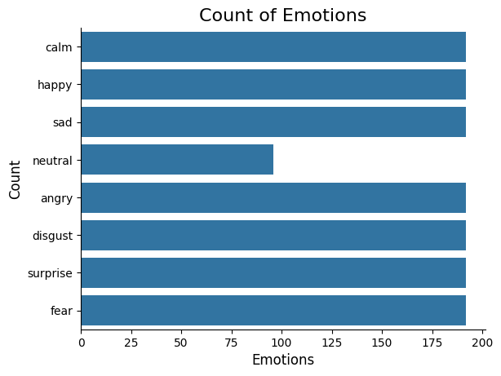
Dataset
Speech Dataset:-
RAVDESS Dataset: Ryerson Audio-Visual Database of Emotional Speech and Song
Developed by: Ryerson University
The dataset includes 8 emotions:Neutral, Calm, Happy, Sad, Angry, Fearful, Disgust, and Surprised with a total of 1440 files.
Format:Modality-SpeechType-Emotion-Intensity-Statement-Repetition-Actor.wav
Example: 03-01-04-01-02-01-01.wav

Slide 25
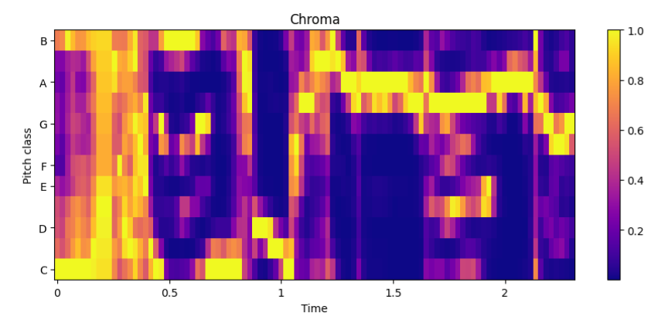
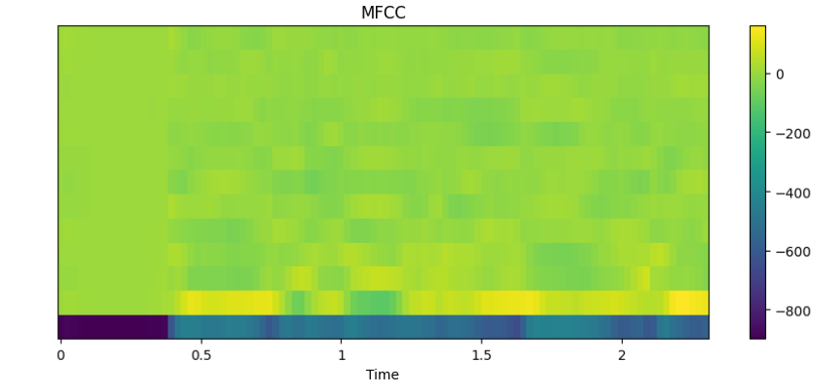
Results and Discussion
➔ "MFCCs capture the speech texture and are crucial for distinguishing emotional tones."
➔ "Chroma features represent the pitch content across time, highlighting musical elements in speech."

Slide 26
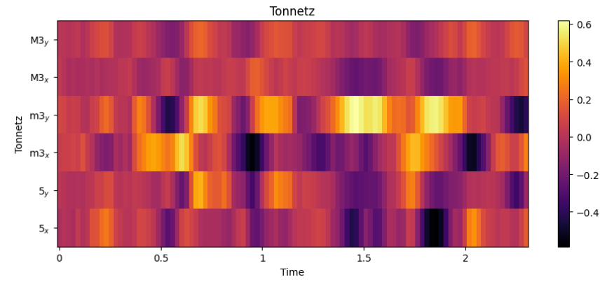
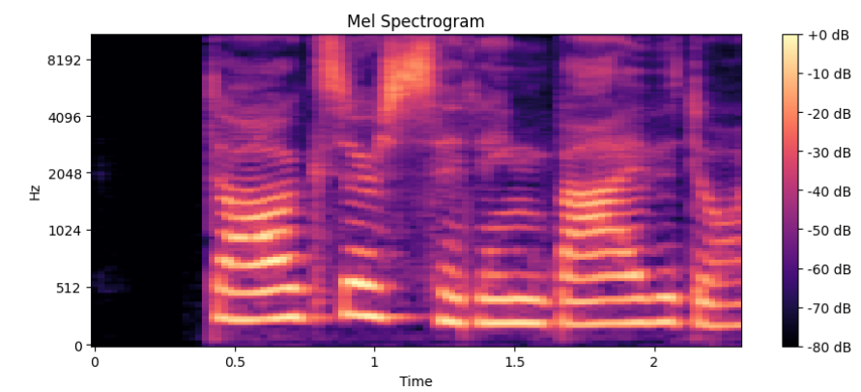
Contd…
➔ "Tonnetz shows harmonic relations, important for detecting tonal emotions."
➔ "Mel spectrogram visualizes energy patterns across frequency bands over time."

Slide 27
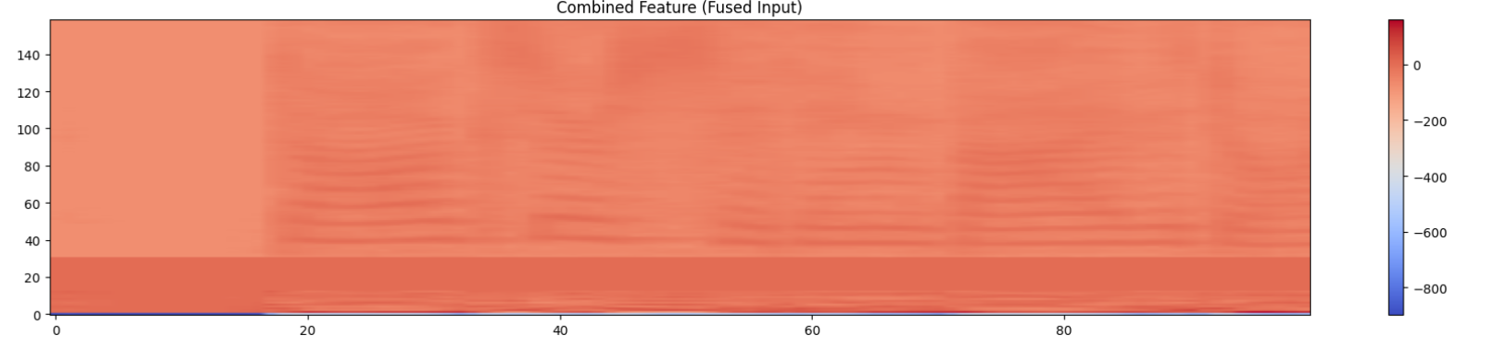
Contd…
➔ "Fusion of MFCC, Chroma, Tonnetz, and Mel features provides a comprehensive audio representation."

Slide 28
Feature Comparison
Feature | What it represents | Why it's important
MFCC (Mel-frequency cepstral coefficients) | Represents the timbre and texture of the sound (how it "feels") | Important for understanding the voice characteristics
Chroma | Shows pitch classes (notes) across time | Useful because emotions often involve pitch changes (like high-pitched anger, low-pitched sadness)
Tonnetz | Describes harmonic relationships | Captures musicality and tonal shifts, which can also reflect emotion
Mel Spectrogram | Shows energy in different frequency bands over time | Helps visualize intensity, rhythm, and patterns in speech
Combined Features | A fused view of all important aspects | Model gets fuller information to make better predictions

Slide 29
Contd…
Input is a fused feature vector of shape (100, 159) per sample.
A linear layer reduces features from 159 to 128 → shape becomes (batch_size, 100, 128).
Learnable positional encoding is added to retain the order of time steps.
Input is reshaped to (100, batch_size, 128) for the transformer encoder.
Transformer encoder uses:
Multi-head self-attention to capture temporal relationships.
Feed-forward layers to process token-wise representations.
Layer normalization and residual connections.
2 stacked transformer layers.Output is mean-pooled across the 100 time steps → shape becomes (batch_size, 128).
A final linear layer maps this to 8 emotion classes → output shape: (batch_size, 8).

Slide 30
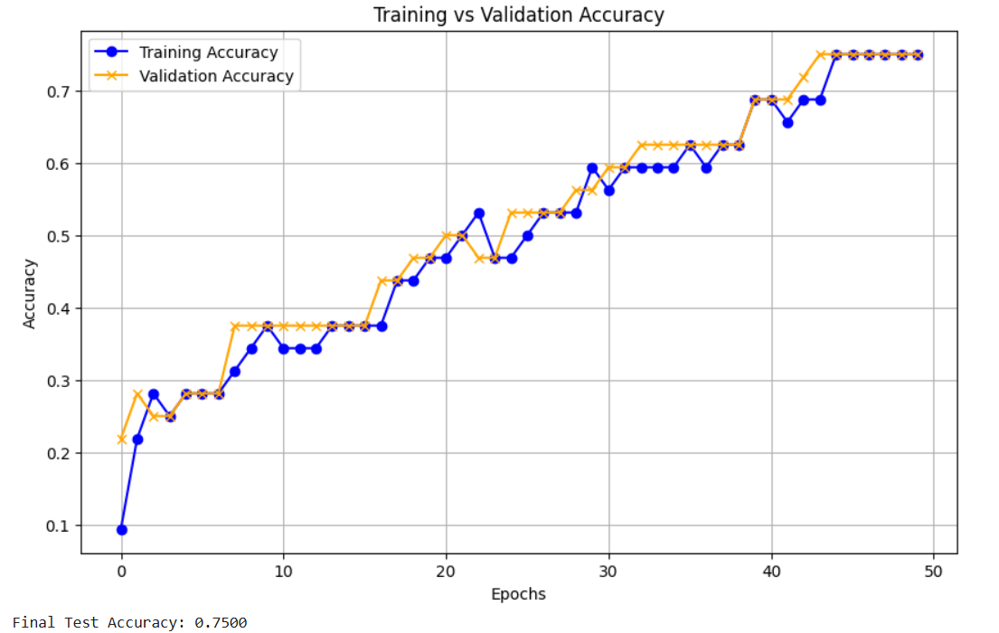
Contd…

Slide 31
Conclusion
The project successfully performs speech emotion classification using fused acoustic features.
Transformer model provides reliable emotion recognition across 8 distinct categories.
The system shows strong potential for applications in human-computer interaction and affective computing.
Highlights the importance of feature fusion for improved emotion detection accuracy.
The approach demonstrates the relevance of deep learning in understanding human emotions through speech.

Slide 32
FUTURE SCOPE
Incorporate real-time emotion recognition for interactive applications.
Extend the model to multimodal emotion recognition by combining audio with facial expressions or text.
Explore transfer learning with larger pre-trained models for better performance.
Improve robustness to noise and different accents or speech variations.
Deploy the system in real-world applications like virtual assistants, call centers, and mental health monitoring.
Expand the dataset to include more diverse languages and emotional categories.

Slide 33
References
[1] S. Ma, C. Luo, C. Fan, and J. Hu, “Clustering Based Speech Emotion Recognition by Incorporating Learned Features and Deep BiLSTM,” Applied Sciences, vol. 11, no. 22, p. 10854, 2021, doi: 10.3390/app112210854.
[2] J. Y. Lee, H. Choi, and K. Lee, “Classification of Speech Emotion State Based on Feature Map Fusion of TCN and Pretrained CNN Model From Korean Speech Emotion Data,” IEEE Access, vol. 10, pp. 116339–116351, 2022, doi: 10.1109/ACCESS.2022.3217166.
[3] D. Kwon, Y. Park, H. Kim, and J. Lee, “3D Convolutional Neural Network for Speech Emotion Recognition With Its Realization on Intel CPU and NVIDIA GPU,” in Proc. Int. Conf. Artificial Intelligence in Information and Communication (ICAIIC), 2021, pp. 196–201, doi: 10.1109/ICAIIC51459.2021.9415211.
[4] A. Ghosh, D. Sen, and A. Das, “Autoencoder With Emotion Embedding for Speech Emotion Recognition,” IEEE Access, vol. 10, pp. 12345–12356, 2022, doi: 10.1109/ACCESS.2022.3146783.
[5] M. Rehman, Z. Ali, and J. Gwak, “Lightweight Deep Learning Framework for Speech Emotion Recognition,” Sensors, vol. 22, no. 14, p. 5191, 2022, doi: 10.3390/s22145191.

Slide 34
THANK YOU!

